Slide 1
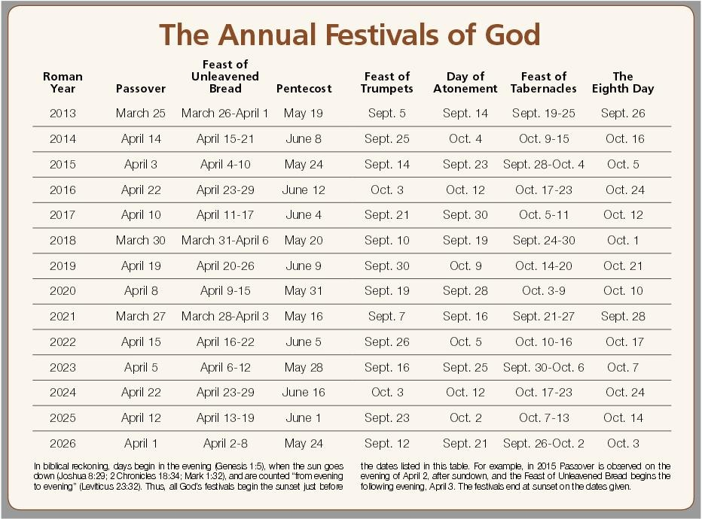

Slide 2
Lev 23:37 These are the feasts of the LORD, which ye shall proclaim to be holy convocations, to offer an offering made by fire unto the LORD, a burnt offering, and a meat offering, a sacrifice, and drink offerings, every thing upon his day:
Seventh Day Sabbath: Holy Convocation (Every Sabbath) Lev. 23:3
Passover/Unleavened Bread: Holy convocation/Annual Sabbaths (1st & 7th Day) Lev.23:7
Feast of First Fruits: Lev. 23:9-14
Feast of Weeks/Pentecost: Holy Convocation /Annual Sabbath (50th Day) Lev. 23:21
Feast of Trumpets: Holy Convocation / Annual Sabbath (1st Day) Lev. 23:24
Day of Atonement: Holy Convocation /Annual Sabbath (10th Day 7th Month) Lev. 23:27
Feast of Tabernacles: Holy Convocation / Annual Sabbaths (1st & 8th Day) Lev 23:35
The Eighth Day: Holy Convocation /Annual Sabbaths Lev. 23:36

